Slide 1

SEMINAR INTERNASIONAL PGSD KE-6
Pengembangan Pedagogik dari Perspektif Pendidikan Abad 21 dan Kerja Sama Komunitas Pendidik Serantau
THE GOLDEN ASEAN AGE
FOR TEACHER DEVELOPMENT
SHAIK ABDUL MALIK MOHAMED ISMAIL
UNIVERSITI SAINS MALAYSIA
15 SEPTEMBER 2015

Slide 2
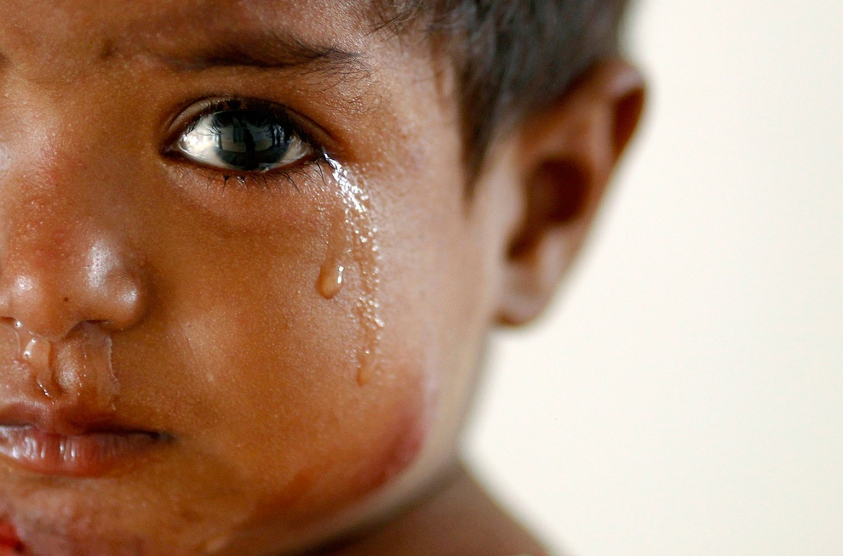
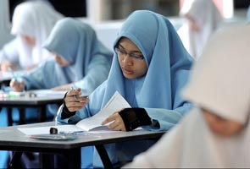
WHO WILL BE THEIR TEACHERS ….?
SA MALIK

Slide 3


… AND WHAT ABOUT THE FATE OF OUR TEACHERS!

Slide 4

Pendidikan adalah senjata paling kuat yang boleh digunakan untuk mengubah dunia
SA MALIK

Slide 5
"In almost every area of human endeavour, the practice improves over time …that hasn't been the case for teaching“
Microsoft co-founder Bill Gates.
SA MALIK

Slide 6
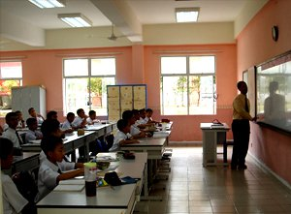
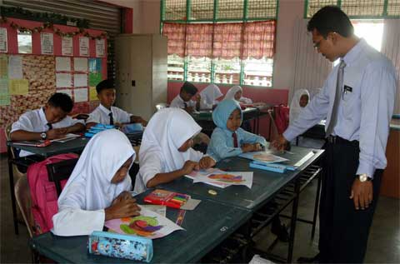
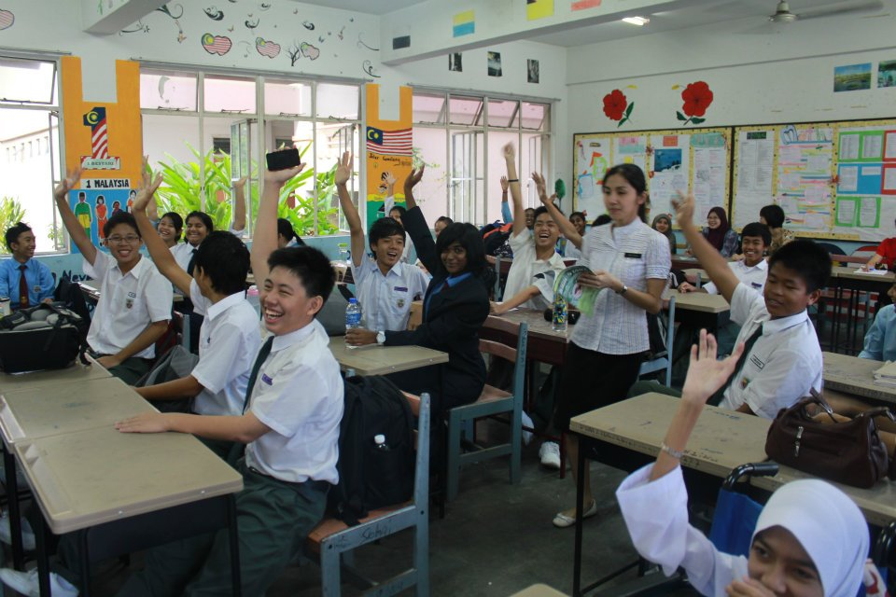

Slide 7
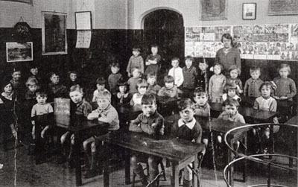
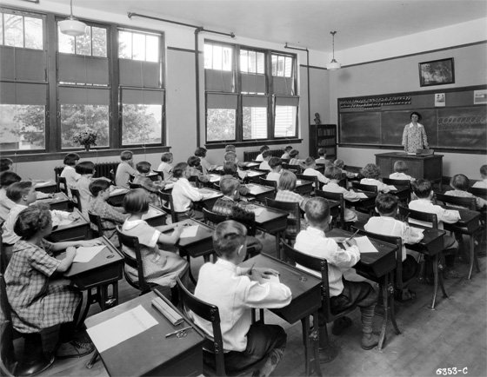

Slide 8
THE GOLDEN ASEAN AGE
FOR TEACHER DEVELOPMENT
The ASEAN region is currently faced with a considerable challenge as the implementation of the ASEAN Economic Community (AEC) is supposed to take off later this year (2015)
SA MALIK

Slide 9
Snipped about AEC
The ASEAN Economic Community (AEC) shall be the goal of regional economic integration by 2015.
AEC envisages the following key characteristics: (a) a single market and production base, (b) a highly competitive economic region, (c) a region of equitable economic development, and (d) a region fully integrated into the global economy.
The AEC areas of cooperation include human resources development and capacity building; recognition of professional qualifications; closer consultation on macroeconomic and financial policies; trade financing measures; enhanced infrastructure and communications connectivity; development of electronic transactions through e-ASEAN; integrating industries across the region to promote regional sourcing; and enhancing private sector involvement for the building of the AEC. In short, the AEC will transform ASEAN into a region with free movement of goods, services, investment, skilled labour, and freer flow of capital.
The ASEAN countries are engaged in a process to transform ASEAN into a real economic community by the end of 2015
Key AEC Messages
“ASEAN PROFESSIONALS ON THE MOVE”
“BEST PEOPLE AND BEST PRACTICES”

Slide 10
SUBSEQUENTLY:
Enactment of AEC is expected to be the first strategic step for ASEAN countries in building the framework of strengthening the character and quality of education to the ‘Golden Generation’
This is the dream of all the countries in the region particularly Indonesia, Malaysia, Thailand, and Philippines

Slide 11
ASEAN Superior TEACHERS …
One of the efforts that could be pursued within the framework of strengthening the development of superior character is mastering and understanding the pedagogical strategies that are effective and efficient.
The presence of pedagogic needs to be understood in broad terms are about how the pedagogical background, purpose and objectives, as well as the type of substance and implementation on the ground in improving the quality of education.
SA MALIK

Slide 12
IN SHORT THIS IS AN ISSUE OF
PROFESSIONALISM …
SA MALIK

Slide 13
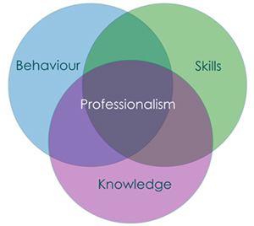
CHARACTERISTICS OF PROFESSIONALISM ….
PROFESSIONALISM
BEHAVIOUR
SKILLS
KNOWLEDGE
SA MALIK

Slide 14
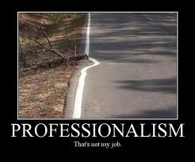
LACK OF PROFESSIONALISM ….
LACK OF PROFESSIONALISM AMONG TEACHERS …
lack of any effective system of licensing
lack of agreed standards for performance
lack of incentives for competent and dedicated people to join the profession
work settings that do not provide a collegial atmosphere and appropriate set-up for the growth and development of ‘professionalism’
assortment of prevailing systems of teacher education and the lack of interaction, which hinders standardization in the teaching profession
SA MALIK

Slide 15

PROFESSIONALISM IS ….
the ‘quality of the practice’
character; commitment; subject knowledge and; pedagogical knowledge
certain standards in relation to knowledge, skills and behavior
SA MALIK

Slide 16
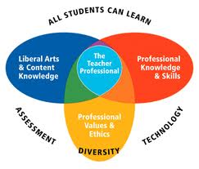
PROFESSIONS, PROFESSIONALS AND PROFESSIONALISM …
PROFESSIONS
status
PROFESSIONALS
certification
PROFESSIONALISM
standard
acceptance
reward
skill & expertise
responsibility & accountability
codes
SA MALIK

Slide 17
ASEAN PROFESSIONAL TEACHERS …
PROFESSION ORIENTED VIRTUES:
expertise,
competency
effectiveness;
flexibility
responsiveness
responsibility and
autonomy
ENTREPRENEURIAL OR MARKET-ORIENTED VIRTUES:
accountability
SA MALIK

Slide 18
DEVELOPING ASEAN TEACHERS’ PROFESSIONAL STANDARD…
How do we differentiate competent teachers from ineffective teachers?
What’s the yardstick?
STANDARD
… to benchmark the quality of the practice for e.g. doctors, lawyers, engineers, architects etc. …
What about teachers’ standard?
COMPETENCY
SA MALIK

Slide 19
A SINGLE ASEAN TEACHERS’ CERTIFICATION …
Certification and licensing
Accredits their competence and qualifications
Accountability
Those who have achieved a set standard
Are our teachers qualified, certified and licensed?
Who will ascertained their expertise and who certified and licensed them?
On what basis are these teachers licensed?
What are they licensed to do?
SA MALIK

Slide 20
TEACHING AS A VIABLE PROFESSION …
A VIABLE PROFESSION ENTAILS:
a coherent body of knowledge and skills;
some form of ‘professional’ control over admission to teacher education programs and of autonomy in deciding the appropriate knowledge, skills, and standard;
a level of consistency in teacher education candidates and;
a clear demarcation between qualified and unqualified candidates and legitimate programs and illegitimate programs.
BUT:
there is no formal framework for coordinating efforts across boundaries in teacher certification.
Consequently,
this apparent lack of global or even regional legal sanctioning resulted in little global cooperation and limits the mobility of teachers whose credential do not have common understanding nor universal standards.
SA MALIK

Slide 21
ASEAN NEED A DYNAMIC CURRICULUM TO GROOM HER TEACHERS ….
BLENDED LEARNING
PROJECT BASED LEARNING
TECH INTERGRATION & VIRTUAL LEARNING PLATFORMS
COMMUNITY BASED LEARNING
GLOBAL CONNECTIONS
ESSENTIAL SKILL DEVELOPMENT
TEACHER & PEER LED INSTRUCTION
SA MALIK

Slide 22
ASEAN COMMON TEACHING STANDARDS …
SO WHAT IS THE EXPECTATION FOR THE TEACHING PROFESSION?
What teachers or educators are expected to know and;
SO WHAT IS TEACHER EFFECTIVENESS THEN?
Be able to do
Design / planning learning activities and/or programmes of study;
Teaching and supporting student learning; assessment and giving feedback to learners;
Developing effective learning environments student guidance and support
System integration of scholarship, research and professional activities with teaching and supporting learning;
Evaluation of practice and continuing professional development.
SA MALIK

Slide 23
SO WHAT IS THE STANDARD FOR THE ASEAN TEACHERS …
WHAT TEACHERS OR EDUCATORS ARE EXPECTED TO KNOW!
the subject matter;
WHAT THEY ARE BE ABLE TO DO!
design and planning of learning activities and/or programmes of study;
appropriate methods for teaching and learning in the subject area and at the level of the academic programme;
how students learn, both generally and in the subject;
the use of appropriate learning technologies;
methods for evaluating the effectiveness of teaching;
implications of quality assurance and enhancement for professional practice
teaching and supporting student learning;
assessment and giving feedback to learners;
developing effective learning environments and student guidance and support
system;
integration of scholarship, research and professional activities with teaching and
supporting learning; and
evaluation of practice and continuing professional development.
SA MALIK

Slide 24
ASEAN TEACHERS ETHICAL STANDARDS …
ETHICS
Professional ethics is needed for political legitimation
TEACHERS’ ETHICS?
The professional practices of teachers can be the basis upon which an ethical standard can be built
The nature of the ethical responsibilities held in common by its members
SA MALIK

Slide 25
MOVING ASEAN FORWARD …
Adopting & Reforming
Adopting best practices in Reforming the way we operate teacher education
Adapting & Restructuring
Adapting quality systems in Restructuring our organization of teacher education
Altering & Remodeling
Altering our paradigm about teacher education to remodel the manner teacher operates in the classroom
Adding new dreams, ideas, concepts and innovations in Rebranding Teacher Education
Adding & Rebranding
SA MALIK

Slide 26


WE NEED NEW BREED OF TEACHERS FOR ASEAN …
WE ARE CONCERN WITH GLOBAL WARMING!
THEREFORE, WE SHOULD BE RETHINKING ABOUT OUR:
BUT WHAT ABOUT THE RAISE OF GLOBAL YAWNING IN THE CLASSROOMS OF THE WORLD
CERTIFICATION;
LICENSING PRACTICES
PROMOTION CRITERIA; AND
SA MALIK

Slide 27
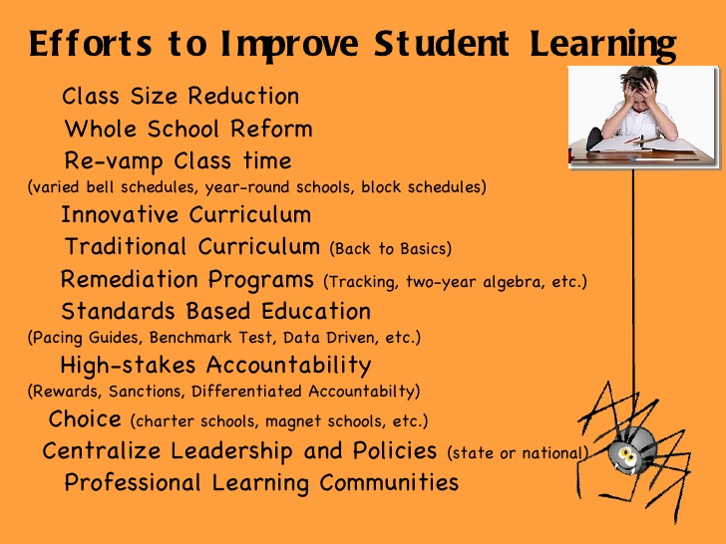
Going back to basics:
Before we decide what kind of teacher education we want, we must decide
what kind of society to build …

Slide 28
Liberalization in 2015
The rise of Asia is unstoppable and the 21st century is the Asian Century
Tomorrow’s economy, education and skill, commerce, regional security and culture is all about Asia
Upon liberalization of ASEAN economic community, we are no longer preparing our students for the local market but also the ASEAN market
Are we preparing our students to face the new challenges upon liberalization

Slide 29


21st CENTURY CHALLENGES TO EDUCATION
GLOBAL
ACCELERATING
PACE OF
CHANGE
ECONOMIC CRISIS
  We need to cut overhead costs
  We need to reduce central administrative costs while increasing number of services
  We need to increase the quality of service provided
  We need to increase employee productivity despite the lack of new posts
  We need to retool in order to retrain staff that understands and can cope in the times of increasing market pressures
  We need to ensure staff undergo multitasking
  Digital age; Information overload,
  Teachers need to be efficient and effective
GLOBALIZATION
GLOBAL
COMPETITION
WITH ADVENT OF
  World is now borderless
  We need to create track record
  We need branding and positioning

Slide 30



SO WHERE DO WE STAND …
SA MALIK

